Slide 1
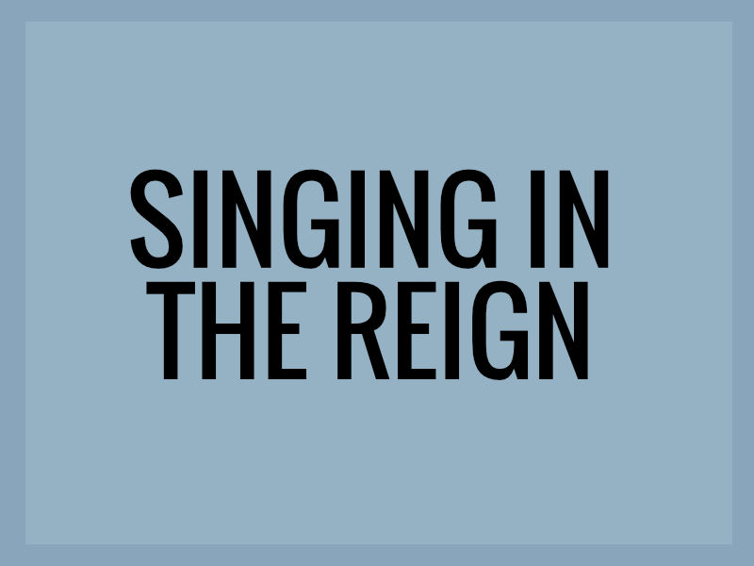
June 20, 2021
Psalm 47

Slide 2
Psalm 47:1-9
For the choir director. A Psalm of the sons of Korah.
1 O clap your hands, all peoples; Shout to God with the voice of joy. 2 For the Lord Most High is to be feared, A great King over all the earth. 3 He subdues peoples under us And nations under our feet. 4 He chooses our inheritance for us, The glory of Jacob whom He loves. Selah. 5 God has ascended with a shout, The Lord, with the sound of a trumpet. 6 Sing praises to God, sing praises; Sing praises to our King, sing praises. 7 For God is the King of all the earth; Sing praises with a skillful psalm. 8 God reigns over the nations, God sits on His holy throne. 9 The princes of the people have assembled themselves as the people of the God of Abraham, For the shields of the earth belong to God; He is highly exalted.

Slide 3
Psalm 46:1-2
God is our refuge and strength,
a very present help in trouble.
Therefore we will not fear…

Slide 4
Psalm 47:1-9
For the choir director. A Psalm of the sons of Korah.
1 O clap your hands, all peoples; Shout to God with the voice of joy. 2 For the Lord Most High is to be feared, A great King over all the earth. 3 He subdues peoples under us And nations under our feet. 4 He chooses our inheritance for us, The glory of Jacob whom He loves. Selah. 5 God has ascended with a shout, The Lord, with the sound of a trumpet. 6 Sing praises to God, sing praises; Sing praises to our King, sing praises. 7 For God is the King of all the earth; Sing praises with a skillful psalm. 8 God reigns over the nations, God sits on His holy throne. 9 The princes of the people have assembled themselves as the people of the God of Abraham, For the shields of the earth belong to God; He is highly exalted.

Slide 5
Singing in the Reign – Psalm 47
Rejoice in the Awesomeness of God (1-4)
The call to rejoice in the Awesomeness of God (1-2)

Slide 6
Isaiah 55:11-12
11 So will My word be which goes forth from My mouth; It will not return to Me empty, Without accomplishing what I desire, And without succeeding in the matter for which I sent it. 12 For you will go out with joy And be led forth with peace; The mountains and the hills will break forth into shouts of joy before you, And all the trees of the field will clap their hands.

Slide 7
Lamentations 2:15
All who pass along the way clap their hands in derision at you; They hiss and shake their heads At the daughter of Jerusalem, "Is this the city of which they said, 'The perfection of beauty, A joy to all the earth'?"

Slide 8
Singing in the Reign – Psalm 47
Rejoice in the Awesomeness of God (1-4)
The call to rejoice in the Awesomeness of God (1)
The cause of rejoicing in the Awesomeness of God (2)
The care that comes from rejoicing in the Awesomeness of God (3-4)

Slide 9
Ephesians 1:3-6
3 Blessed be the God and Father of our Lord Jesus Christ, who has blessed us with every spiritual blessing in the heavenly places in Christ, 4 just as He chose us in Him before the foundation of the world, that we would be holy and blameless before Him. In love 5 He predestined us to adoption as sons through Jesus Christ to Himself, according to the kind intention of His will, 6 to the praise of the glory of His grace, which He freely bestowed on us in the Beloved.

Slide 10
Singing in the Reign – Psalm 47
Rejoice in the Ascension of God (5-7)
The cause of rejoicing in the Ascension of God (5)
The call to rejoice in the Ascension of God (6-7)

Slide 11
Spurgeon
“We must not be guided by the time, but the words of the Psalm; we must mind the matter more than the music, and consider what we sing, as well as how we sing; the tune may affect the fancy, but it is the matter that affects the heart, and that God principally eyes.”

Slide 12
1 Corinthians 14:15
What is the outcome then? I will pray with the spirit and I will pray with the mind also; I will sing with the spirit and I will sing with the mind also.

Slide 13
Psalm 47 – How to rejoice and praise God
We are to praise Him cheerfully when we clap [our] hands as an expression of our inward joy.
We are to praise Him universally together with all peoples who should praise the Lord.
We are to praise Him vocally as we shout unto God with the voice of triumph and joy.
We are to praise Him frequently, as the idea of sing praises is repeated over and over. In other words, we cannot praise the Lord too much.
We are to praise Him intelligently, as we sing praises with a skillful psalm. We are to know and proclaim the reasons for our praise.

Slide 14
Singing in the Reign – Psalm 47
Rejoice in the Authority of God (8-9)
The causes for rejoicing in the Authority of God (8-9a)
The celebration of the Authority of God (9b)

Slide 15
June 20, 2021
Psalm 47

